Slide 1
Welcome to the world of AI
Artificial Intelligence & Expert Systems
Dr. Bidush Kumar Sahoo
GIET University, Gunupur

Slide 2
Course Learning Outcomes
To describe the basic fundamental concepts of Artificial Intelligence, Agents, and Environment.
Comparing traditional solutions to different problems and their expected AI-based solutions.
Demonstrating problem-solving methods with various AI-based technologies.
Correlating awareness of informed search and uninformed search techniques.
Designing AI-based problem-solving strategies for intelligent applications in the real world
Dr. Bidush Kumar Sahoo Group No.: AIML

Slide 3
Reference Books/Websites
Reference Books:
1. Artificial Intelligence: A Modern Approach-2nd Edition, Stuart Russel, Peter Norvig, Pearson Education
2. Introduction to Artificial Intelligence & Expert Systems by Dan W. Patterson, Englewood Cliffs, NJ, 1990 (Prentice Hall International)
3. Artificial Intelligence by Elaine Rich, Kevin Knight, Shivashankar B Nair, (McGraw-Hill)
Relevant Websites:
  http://www.cs.utexas.edu/~novak/cs381kcontents.html
  https://www.udacity.com/course/intro-to-artificial-intelligence--cs271
  http://nptel.ac.in/courses/106105077
Dr. Bidush Kumar Sahoo Group No.: AIML

Slide 4
Lecture Objectives
By the end of this lecture, you will be able to :
Define artificial intelligence.
Define history of intelligence.
Explain applications of artificial intelligence in briefly with suitable examples.
Define future of Artificial Intelligence
Dr. Bidush Kumar Sahoo Group No.: AIML

Slide 5
Chapter 1
Introduction
Dr. Bidush Kumar Sahoo Group No.: AIML

Slide 6
History of AI
Important research that laid the groundwork for AI:
In 1931, Goedel layed the foundation of Theoretical Computer Science1920-30s:
He published the first universal formal language and showed that math itself is either flawed or allows for unprovable but true statements.
In 1936, Turing reformulated Goedel’s result and church’s extension thereof.
In 1956, John McCarthy coined the term "Artificial Intelligence" as the topic of the Dartmouth Conference, the first conference devoted to the subject.
In 1957, The General Problem Solver (GPS) demonstrated by Newell, Shaw & Simon
In 1958, John McCarthy (MIT) invented the Lisp language.
In 1959, Arthur Samuel (IBM) wrote the first game-playing program, for checkers, to achieve sufficient skill to challenge a world champion.
In 1963, Ivan Sutherland's MIT dissertation on Sketchpad introduced the idea of interactive graphics into computing.
In 1966, Ross Quillian (PhD dissertation, Carnegie Inst. of Technology; now CMU) demonstrated semantic nets
Dr. Bidush Kumar Sahoo Group No.: AIML

Slide 7
History of AI
In 1967, Dendral program (Edward Feigenbaum, Joshua Lederberg, Bruce Buchanan, Georgia Sutherland at Stanford) demonstrated to interpret mass spectra on organic chemical compounds. First successful knowledge-based program for scientific reasoning.
In 1967, Doug Engelbart invented the mouse at SRI
In 1968, Marvin Minsky & Seymour Papert publish Perceptrons, demonstrating limits of simple neural nets.
In 1972, Prolog developed by Alain Colmerauer.
In Mid 80’s, Neural Networks become widely used with the Backpropagation algorithm (first described by Werbos in 1974).
1990, Major advances in all areas of AI, with significant demonstrations in machine learning, intelligent tutoring, case-based reasoning, multi-agent planning, scheduling, uncertain reasoning, data mining, natural language understanding and translation, vision, virtual reality, games, and other topics.
In 1997, Deep Blue beats the World Chess Champion Kasparov.
In 2002,iRobot, founded by researchers at the MIT Artificial Intelligence Lab, introduced Roomba, a vacuum cleaning robot. By 2006, two million had been sold
Dr. Bidush Kumar Sahoo Group No.: AIML

Slide 8
Introduction
1. AI as a field of study
  Computer Science, Cognitive Science, Psychology, Philosophy, Linguistics, Neuroscience as shown in fig 1.1 of next slide.
2. AI is part science, part engineering
3. AI often must study other domains in order to implement systems e.g., medicine and medical practices for a medical diagnostic system, engineering and chemistry to monitor a chemical processing plant
4. AI is a belief that the brain is a form of biological computer and that the mind is computational
5. AI has had a concrete impact on society but unlike other areas of CS, the impact is often
  felt only tangentially (that is, people are not aware that system X has AI)
  felt years after the initial investment in the technology
Dr. Bidush Kumar Sahoo Group No.: AIML

Slide 9
Intelligence?
Is there a “holistic” definition for intelligence?
Here are some definitions:
  the ability to comprehend; to understand and profit from experience
  a general mental capability that involves the ability to reason, plan, solve problems, think abstractly, comprehend ideas and language, and learn
  is effectively perceiving, interpreting and responding to the environment
None of these tells us what intelligence is, so instead, maybe we can enumerate a list of elements that an intelligence must be able to perform:
  perceive, reason and infer, solve problems, learn and adapt, apply common sense, apply analogy, recall, apply intuition, reach emotional states, achieve self-awareness
Which of these are necessary for intelligence? Which are sufficient?
Artificial Intelligence – should we define this in terms of human intelligence?
  does AI have to really be intelligent?
  what is the difference between being intelligent and demonstrating intelligent behavior?
Dr. Bidush Kumar Sahoo Group No.: AIML

Slide 10
Artificial?
  something that is simulated or made by humans, not by nature. So making the machine intelligent by human.
Dr. Bidush Kumar Sahoo Group No.: AIML

Slide 11
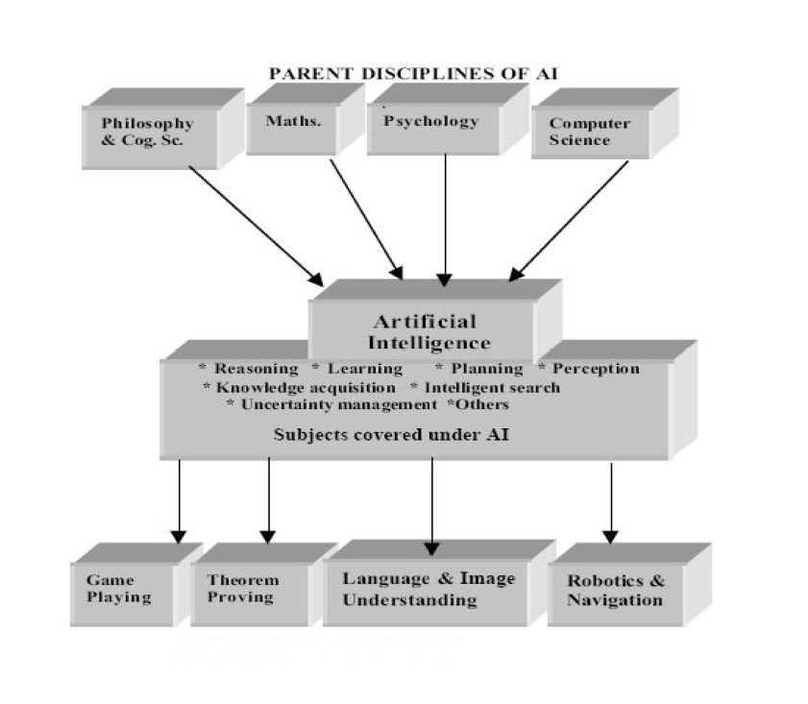
Fig 1.1: Parent Discipline of AI
Introduction
Dr. Bidush Kumar Sahoo Group No.: AIML

Slide 12
Definitions
Let us define Artificial Intelligence now
Artificial Intelligence (AI) is a branch of Science which deals with helping machines find solutions to complex problems in a more human-like fashion.
This generally involves borrowing characteristics from human intelligence, and
applying them as algorithms in a computer friendly way.
A more or less flexible or efficient approach can be taken depending on the
requirements established, which influences how artificial the intelligent
behavior appears.
The automation of activities that we associate with human thinking (e.g., decision-making, learning…)
A field of study that seeks to explain and emulate intelligent behavior in terms of computational processes
The branch of computer science that is concerned with the automation of intelligent behavior
Dr. Bidush Kumar Sahoo Group No.: AIML

Slide 13
Other Perspectives
Artificial intelligence can be viewed from a variety of perspectives: -
From the perspective of intelligence artificial intelligence is making machines "intelligent" -- acting as we would expect people to act.
From a business perspective AI is a set of very powerful tools, and methodologies for using those tools to solve business problems.
From a programming perspective, AI includes the study of symbolic programming, problem solving, and search.
  Typically AI programs focus on symbols rather than numeric processing.
  Problem solving - achieve goals.
  Search - seldom access a solution directly. Search may include a variety of techniques.
Dr. Bidush Kumar Sahoo Group No.: AIML

Slide 14
AI Programming Languages
-LISP(LISP, an acronym for list processing, is a programming language that was designed for easy manipulation of data strings. Developed in 1959 by John McCarthy, it is a commonly used language for artificial intelligence (AI) programming)
-The second language strongly associated with AI is PROLOG.
PROLOG was developed in the 1970s. PROLOG is based on first order logic(Prolog is a programming language for symbolic, non-numeric computation. It is specially well suited for solving problems that involve objects and relations between objects).
- Object-oriented languages are a class of languages recently used for AI Progarmming.
Object-Oriented languages are Smalltalk, Objective C, C++. Object oriented extensions to LISP (CLOS - Common LISP Object System) and PROLOG (L&O - Logic & Objects) are also used.
-Most Popular language of today associated with AI is Python.
Python is widely used for artificial intelligence, with packages for several applications including General AI, Machine Learning, Natural Language Processing and Neural Networks. The application of AI to develop programs that do human-like jobs and portray human skills is Machine Learning.

Slide 15
Importance of AI
Game Playing
You can buy machines that can play master level chess for a few hundred dollars.
There is some AI in them, but they play well against people mainly through brute
force computation--looking at hundreds of thousands of positions. To beat a world
champion by brute force and known reliable heuristics requires being able to look at
200 million positions per second.
Speech Recognition
In the 1990s, computer speech recognition reached a practical level for limited
purposes. Thus United Airlines has replaced its keyboard tree for flight information
by a system using speech recognition of flight numbers and city names. It is quite
convenient. On the other hand, while it is possible to instruct some computers using
speech, most users have gone back to the keyboard and the mouse as still more
convenient.
Dr. Bidush Kumar Sahoo Group No.: AIML

Slide 16
Importance of AI
Understanding Natural Language
Just getting a sequence of words into a computer is not enough. Parsing sentences is
not enough either. The computer has to be provided with an understanding of the
domain the text is about, and this is presently possible only for very limited domains.
Computer Vision
The world is composed of three-dimensional objects, but the inputs to the human eye
and computers' TV cameras are two dimensional. Some useful programs can work
solely in two dimensions, but full computer vision requires partial three-dimensional
information that is not just a set of two-dimensional views. At present there are only
limited ways of representing three-dimensional information directly, and they are not
as good as what humans evidently use.
Dr. Bidush Kumar Sahoo Group No.: AIML

Slide 17
Importance of AI
Expert Systems
A ``knowledge engineer'' interviews experts in a certain domain and tries to embody their knowledge in a computer program for carrying out some task. One of the first expert systems was MYCIN in 1974, which diagnosed bacterial infections of the blood and suggested treatments. It did better than medical students or practicing doctors, provided its limitations were observed. Namely, its ontology included bacteria, symptoms, and treatments and did not include patients, doctors, hospitals, death, recovery, and events occurring in time. Its interactions depended on a single patient being considered. Since the experts consulted by the knowledge engineers knew about patients, doctors, death, recovery, etc., it is clear that the knowledge engineers forced what the experts told them into a predetermined framework. The usefulness of current expert systems depends on their users having common sense.
Dr. Bidush Kumar Sahoo Group No.: AIML

Slide 18
Importance of AI
Heuristic Classification
One of the most feasible kinds of expert system given the present knowledge of AI is
to put some information in one of a fixed set of categories using several sources of
information. An example is advising whether to accept a proposed credit card
purchase. Information is available about the owner of the credit card, his record of
payment and also about the item he is buying and about the establishment from which
he is buying it (e.g., about whether there have been previous credit card frauds at this
establishment).users having common sense.
Dr. Bidush Kumar Sahoo Group No.: AIML

Slide 19
Why Artificial Intelligence
The main reasons to learn about AI:
➢ With the help of AI, you can create such software or devices which can solve real-world problems very easily and with accuracy such as health issues, marketing, traffic issues, etc.
➢ With the help of AI, you can create your personal virtual Assistant, such as Cortana, Google Assistant, Siri, etc.
➢ With the help of AI, you can build such Robots which can work in an environment where survival of humans can be at risk.
➢ AI opens a path for other new technologies, new devices, and new Opportunities.
Dr. Bidush Kumar Sahoo Group No.: AIML

Slide 20
Goals of Artificial Intelligence
With Artificial intelligence knowledge representation has become easy. Knowledge representation is representing information that machine or computer can understand.
Artificial planning helps agents sequence of actions to perform to achieve goals.
Artificial intelligence main goal is develop intelligent machines that could learn on their own. No more human intervention for feeding data to machines.
With artificial intelligence one can develop machines that can read and understand human languages are known as Natural learning processing. Thanks to natural learning processing acquisition of knowledge became easy.
Artificial Intelligence helps to develop that could act on sensors (take input from sensors) and react accordingly.
Dr. Bidush Kumar Sahoo Group No.: AIML

Slide 21
Advantages of Artificial Intelligence
➢ High Accuracy with fewer errors: AI machines or systems are prone to less errors and high accuracy as it takes decisions as per pre-experience or information.
➢ High-Speed: AI systems can be of very high-speed and fast-decision making; because of that AI systems can beat a chess champion in the Chess game.
➢ High reliability: AI machines are highly reliable and can perform the same action multiple times with high accuracy.
➢ Useful for risky areas: AI machines can be helpful in situations such as defusing a bomb, exploring the ocean floor, where to employ a human can be risky.
➢ Digital Assistant: AI can be very useful to provide digital assistant to the users such as AI technology is currently used by various E-commerce websites to show the products as per customer requirement.
Dr. Bidush Kumar Sahoo Group No.: AIML

Slide 22
Limitations of Artificial Intelligence
➢ High Cost: The hardware and software requirement of AI is very costly as it requires lots of maintenance to meet current world requirements.
➢ Can't think out of the box: Even we are making smarter machines with AI, but still they cannot work out of the box, as the robot will only do that work for which they are trained, or programmed.
➢ No feelings and emotions: AI machines can be an outstanding performer, but still it does not have the feeling so it cannot make any kind of emotional attachment with human, and may sometime be harmful for users if the proper care is not taken.
➢ Increase dependency on machines: With the increment of technology, people are getting more dependent on devices and hence they are losing their mental capabilities.
➢ No Original Creativity: As humans are so creative and can imagine some new ideas
Dr. Bidush Kumar Sahoo Group No.: AIML

Slide 23
Applications of AI
1. AI in Astronomy
Artificial Intelligence can be very useful to solve complex universe problems. AI technology can be helpful for understanding the universe such as how it works, origin, etc.
2. AI in Healthcare
In the last, five to ten years, AI becoming more advantageous for the healthcare industry and going to have a significant impact on this industry. Healthcare Industries are applying AI to make a better and faster diagnosis than humans. AI can help doctors with diagnoses and can inform when patients are worsening so that medical help can reach to the patient before hospitalization.
3. AI in Gaming
AI can be used for gaming purpose. The AI machines can play strategic games like chess, w
here the machine needs to think of a large number of possible places.
4. AI in Finance
AI and finance industries are the best matches for each other. The finance industry is implementing automation, chatbot, adaptive intelligence, algorithm trading, and machine learning into financial processes.
Dr. Bidush Kumar Sahoo Group No.: AIML

Slide 24
Applications of AI
5. AI in Data Security
The security of data is crucial for every company and cyber-attacks are growing very rapidly in the digital world. AI can be used to make your data more safe and secure. Some examples such as AEG bot, AI2 Platform, are used to determine software bug and cyber-attacks in a better way.
6. AI in Social Media
Social Media sites such as Facebook, Twitter, and Snapchat contain billions of user profiles, which need to be stored and managed in a very efficient way. AI can organize and manage massive amounts of data. AI can analyze lots of data to identify the latest trends, hashtag, and requirement of different users.
7. AI in Travel & Transport
AI is becoming highly demanding for travel industries. AI is capable of doing various travel related works such as from making travel arrangement to suggesting the hotels, flights, and best routes to the customers. Travel industries are using AI-powered chatbots which can make human-li
8. AI in Automotive Industry
Some Automotive industries are using AI to provide virtual assistant to their user for better performance. Various Industries are currently working for developing self-driven cars which can make your journey more safe and secure. ke interaction with customers for better and fast response.
Dr. Bidush Kumar Sahoo Group No.: AIML

Slide 25
Applications of AI
9. AI in Robotics
Artificial Intelligence has a remarkable role in Robotics. Usually, general robots are programmed such that they can perform some repetitive task, but with the help of AI, we can create intelligent robots which can perform tasks with their own experiences without pre-programmed. Humanoid Robots are best examples for AI in robotics, recently the intelligent Humanoid robot named as Erica and Sophia has been developed which can talk and behave like humans.
10. AI in Entertainment
We are currently using some AI based applications in our daily life with some entertainment services such as Netflix or Amazon. With the help of ML/AI algorithms, these services show the recommendations for programs or shows.
11. AI in Agriculture
Agriculture is an area which requires various resources, labor, money, and time for best result. Now a day's agriculture is becoming digital, and AI is emerging in this field. Agriculture is applying AI as agriculture robotics, solid and crop monitoring, predictive analysis. AI in agriculture can be very helpful for farmers.
12. AI in E-commerce
AI is providing a competitive edge to the e-commerce industry, and it is becoming more demanding in the e- commerce business. AI is helping shoppers to discover associated products with recommended size, color, or even brand.
Dr. Bidush Kumar Sahoo Group No.: AIML

Slide 26
Types of AI
Weak AI or Narrow AI
➢ Narrow AI is a type of AI which is able to perform a dedicated task with intelligence. The most common and currently available AI is Narrow AI in the world of Artificial Intelligence.
➢ Narrow AI cannot perform beyond its field or limitations, as it is only trained for one specific task. Hence it is also termed as weak AI. Narrow AI can fail in unpredictable ways if it goes beyond its limits.
➢ Apple Siri is a good example of Narrow AI, but it operates with a limited pre-defined range of functions.
➢ IBM's Watson supercomputer also comes under Narrow AI, as it uses an Expert system approach combined with Machine learning and natural language processing.
➢ Some Examples of Narrow AI are playing chess, purchasing suggestions on e-commerce site, self-driving cars, speech recognition, and image recognition.
Dr. Bidush Kumar Sahoo Group No.: AIML

Slide 27
Types of AI
2. General AI
➢ General AI is a type of intelligence which could perform any intellectual task with efficiency like a human.
➢ The idea behind the general AI to make such a system which could be smarter and think like a human by its own.
➢ Currently, there is no such system exist which could come under general AI and can perform any task as perfect as a human.
➢ The worldwide researchers are now focused on developing machines with General AI.
➢ As systems with general AI are still under research and it will take lots of efforts and time
3. Super AI
➢ Super AI is a level of Intelligence of Systems at which machines could surpass human intelligence, and can perform any task better than human with cognitive properties. It is an outcome of general AI.
➢ Some key characteristics of strong AI include capability include the ability to think, to reason, solve the puzzle, make judgments, plan, learn, and communicate by its own.
➢ Super AI is still a hypothetical concept of Artificial Intelligence. Development of such systems in real is still world changing task.
to develop such systems.
Dr. Bidush Kumar Sahoo Group No.: AIML

Slide 28
Techniques of AI
1. Machine Learning
It is one of the applications of AI where machines are not explicitly programmed to perform certain tasks; rather, they learn and improve from experience automatically. Deep Learning is a subset of machine learning based on artificial neural networks for predictive analysis. There are various machine learning algorithms, such as Unsupervised Learning, Supervised Learning, and Reinforcement Learning. In Unsupervised Learning, the algorithm does not use classified information to act on it without any guidance. In Supervised Learning, it deduces a function from the training data, which consists of a set of an input object and the desired output. Reinforcement learning is used by machines to take suitable actions to increase the reward to find the best possibility which should be taken in to account.
2. NLP (Natural Language Processing)
It is the interactions between computers and human language where the computers are programmed to process natural languages. Machine Learning is a reliable technology for Natural Language Processing to obtain meaning from human languages. In NLP, the audio of a human talk is captured by the machine. Then the audio to text conversation occurs, and then the text is processed where the data is converted into audio. Then the machine uses the audio to respond to humans. Applications of Natural Language Processing can be found in IVR (Interactive Voice Response) applications used in call centres, language translation applications like Google Translate and word processors such as Microsoft Word to check the accuracy of grammar in text.
Dr. Bidush Kumar Sahoo Group No.: AIML

Slide 29
Techniques of AI
3. Automation and Robotics
The purpose of Automation is to get the monotonous and repetitive tasks done by machines which also improve productivity and in receiving cost-effective and more efficient results. Many organizations use machine learning, neural networks, and graphs in automation. Such automation can prevent fraud issues while financial transactions online by using CAPTCHA technology. Robotic process automation is programmed to perform high volume repetitive tasks which can adapt to the change in different circumstances.
4. Machine Vision
Machines can capture visual information and then analyze it. Here cameras are used to capture the visual information, the analogue to digital conversion is used to convert the image to digital data, and digital signal processing is employed to process the data. Then the resulting data is fed to a computer. In machine vision, two vital aspects are sensitivity, which is the ability of the machine to perceive impulses that are weak and resolution, the range to which the machine can distinguish the objects. The usage of machine vision can be found in signature identification, pattern recognition, and medical image analysis, etc.
Dr. Bidush Kumar Sahoo Group No.: AIML

Slide 30
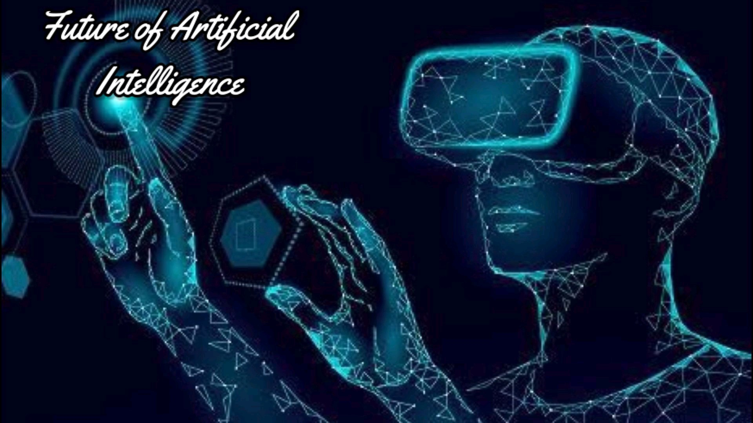
Dr. Bidush Kumar Sahoo Group No.: AIML

Slide 31
Future of AI
Artificial intelligence has acted as the main driver of emerging technologies like - big data, robotics and IoT etc. including other sectors impacting us.
Transportation: Although it could take a decade or more to perfect them, autonomous cars will one day ferry us from place to place.
Manufacturing: AI powered robots work alongside humans to perform a limited range of tasks like assembly and stacking, and predictive analysis sensors keep equipment running smoothly.
Healthcare: In the comparatively AI-nascent field of healthcare, diseases are more quickly and accurately diagnosed, drug discovery is sped up and streamlined, virtual nursing assistants monitor patients and big data analysis helps to create a more personalized patient experience.
Dr. Bidush Kumar Sahoo Group No.: AIML

Slide 32
Future of AI
Education: Textbooks are digitized with the help of AI, early-stage virtual tutors assist human instructors and facial analysis gauges the emotions of students to help determine who’s struggling or bored and better tailor the experience to their individual needs.
Media: Journalism is harnessing AI, too, and will continue to benefit from it. Bloomberg uses Cyborg technology to help make quick sense of complex financial reports. The Associated Press employs the natural language abilities of Automated Insights to produce 3,700 earning reports stories per year — nearly four times more than in the recent past.
Customer Service: Last but hardly least, Google is working on an AI assistant that can place human-like calls to make appointments at, say, your neighborhood hair salon. In addition to words, the system understands context and nuance.
Dr. Bidush Kumar Sahoo Group No.: AIML

Slide 33
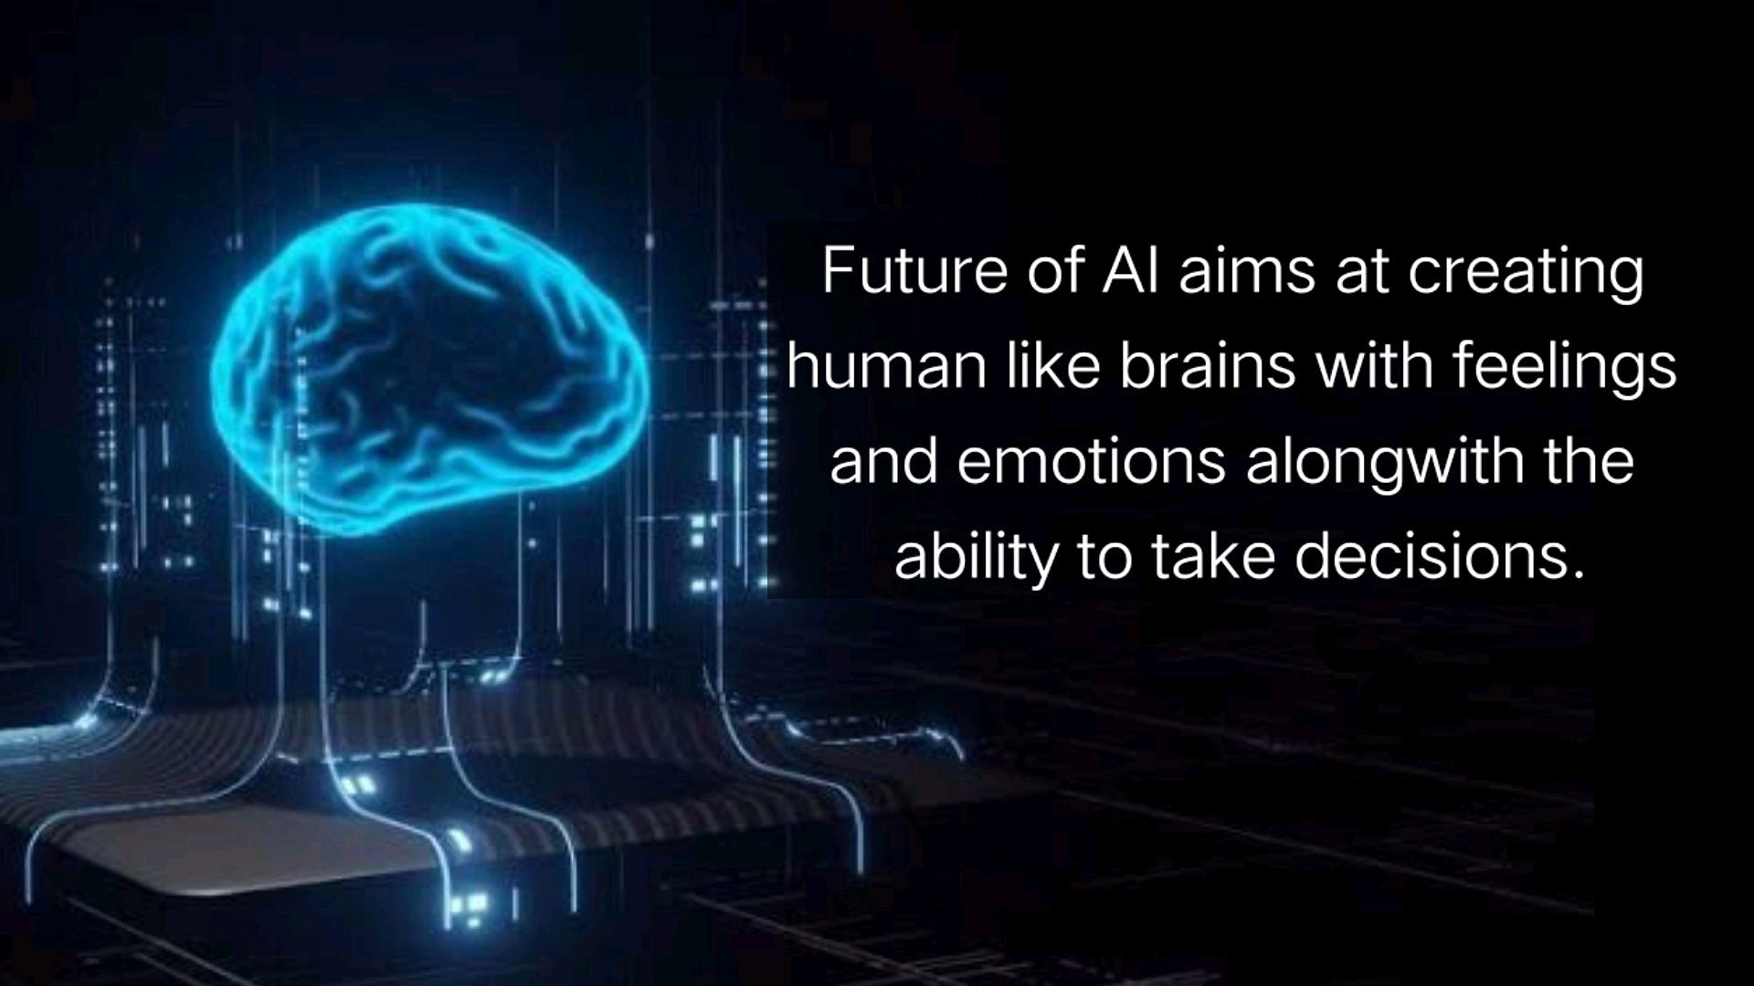
Future of AI
Dr. Bidush Kumar Sahoo Group No.: AIML

Slide 34
THANK YOU
Welcome to AI Team
Dr. Bidush Kumar Sahoo Group No.: AIML

